Slide 1


Movement Primitive Analysis for Movement Recognition A Neuro-AI Pipeline Using Markerless Motion Capture
Arefeh Farahmandi
April 2025

Slide 2
Movement Recognition
What are primitives that distinguish different movements?
Are those primitives aligning with our movement perception?
Can we use these primitives to enhance ML applications?
Movements decomposed into fundamental building blocks called movement primitives, which the nervous system combines flexibly to produce coordinated actions. (Knopp et al. 2020)

Slide 3
Process
TMP model
TMP model requires 3D pose motion data
VIBE : requires multiple view videos
DeepLabCut : requires multiple Camera Calibration
Mmpose : Powefool toolbox for 3D pose extraction
Simple 2D Video
3D pose
Motion Capture
Movement primitives
Notes:
VIBE predicts the parameters of SMPL body model for each frame of an input video.
Patient data
is very limited…

Slide 4
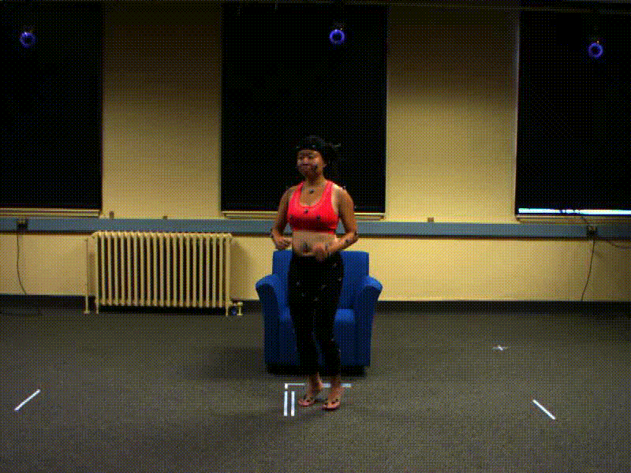
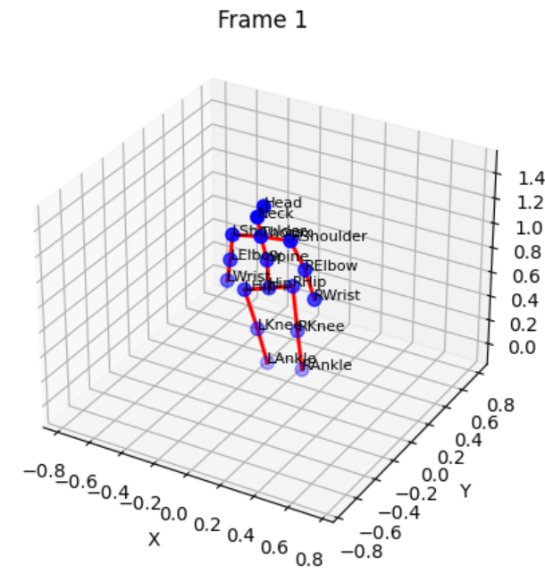
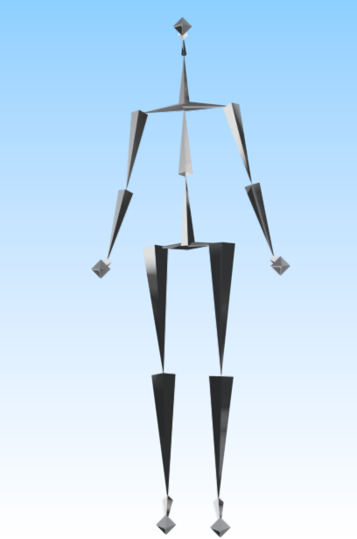
Data Processing
1-Original 2D video
2-MMpose 3D extraction
3-Motion Capture .bvh

Slide 5
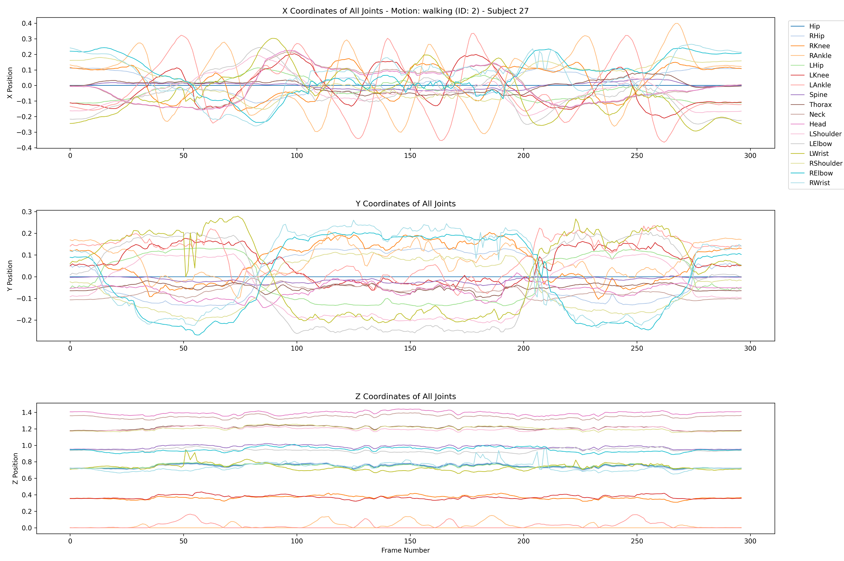
3D data pose
Motion: walking
Subject_id : 27

Slide 6
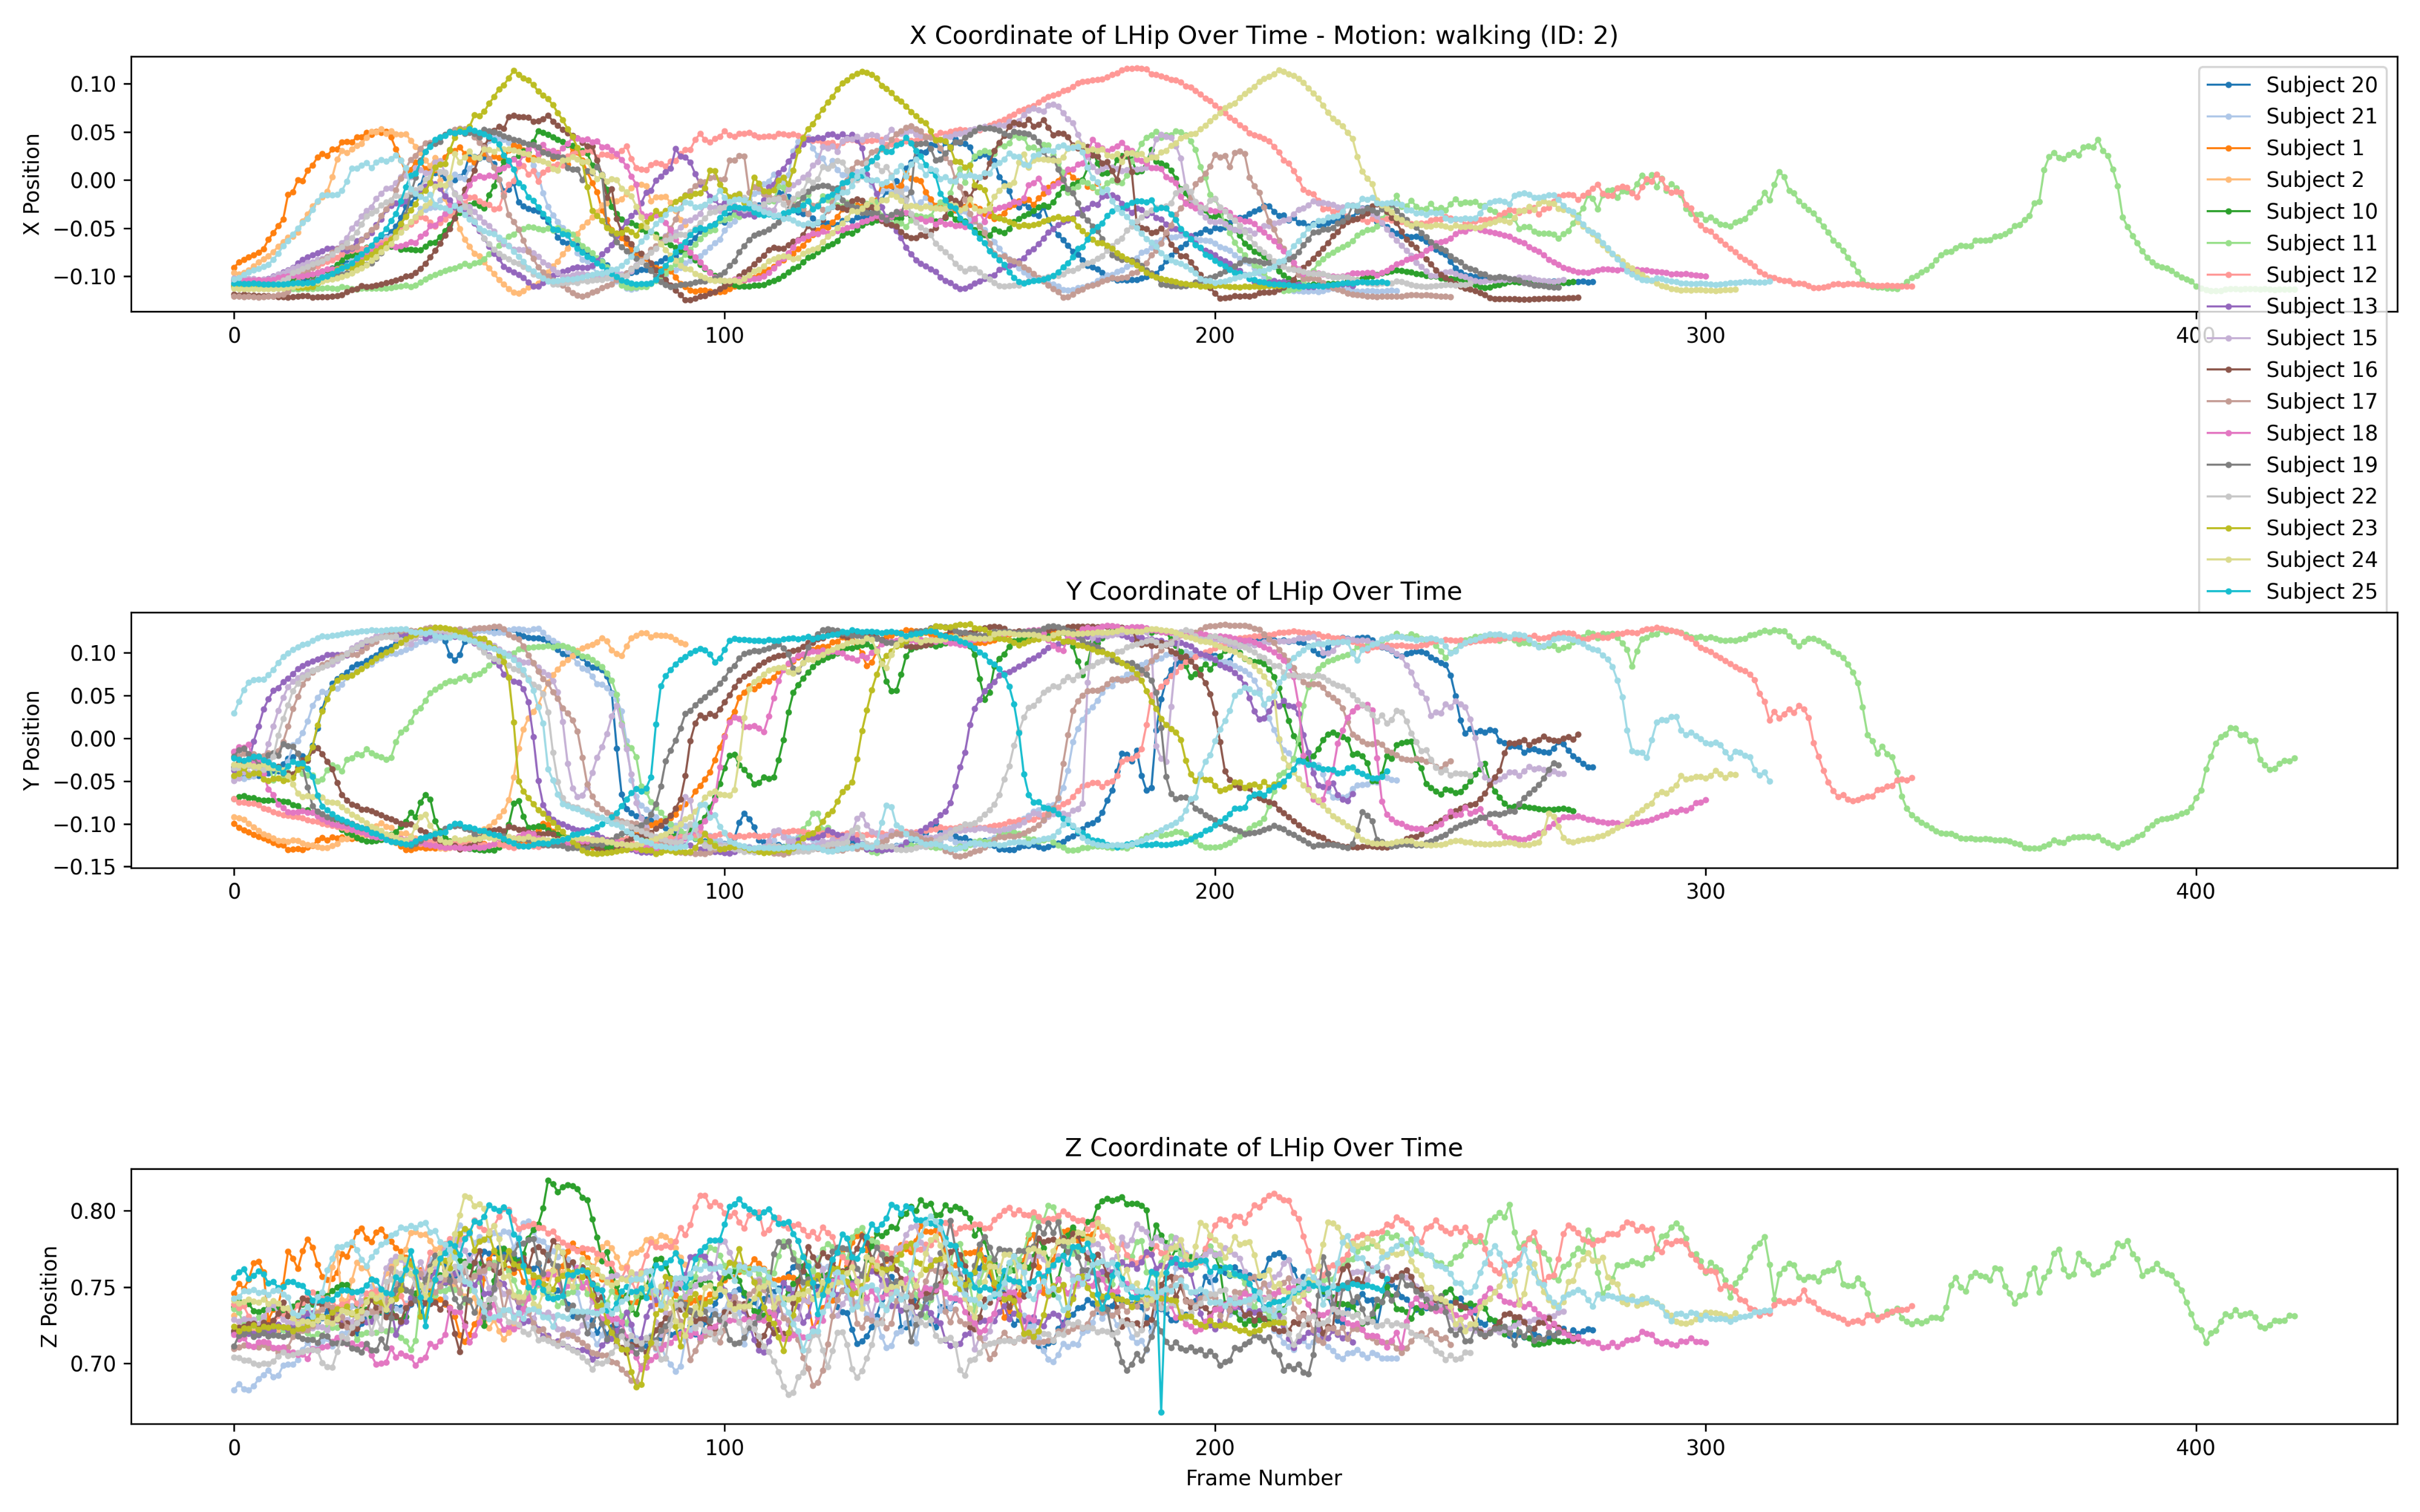
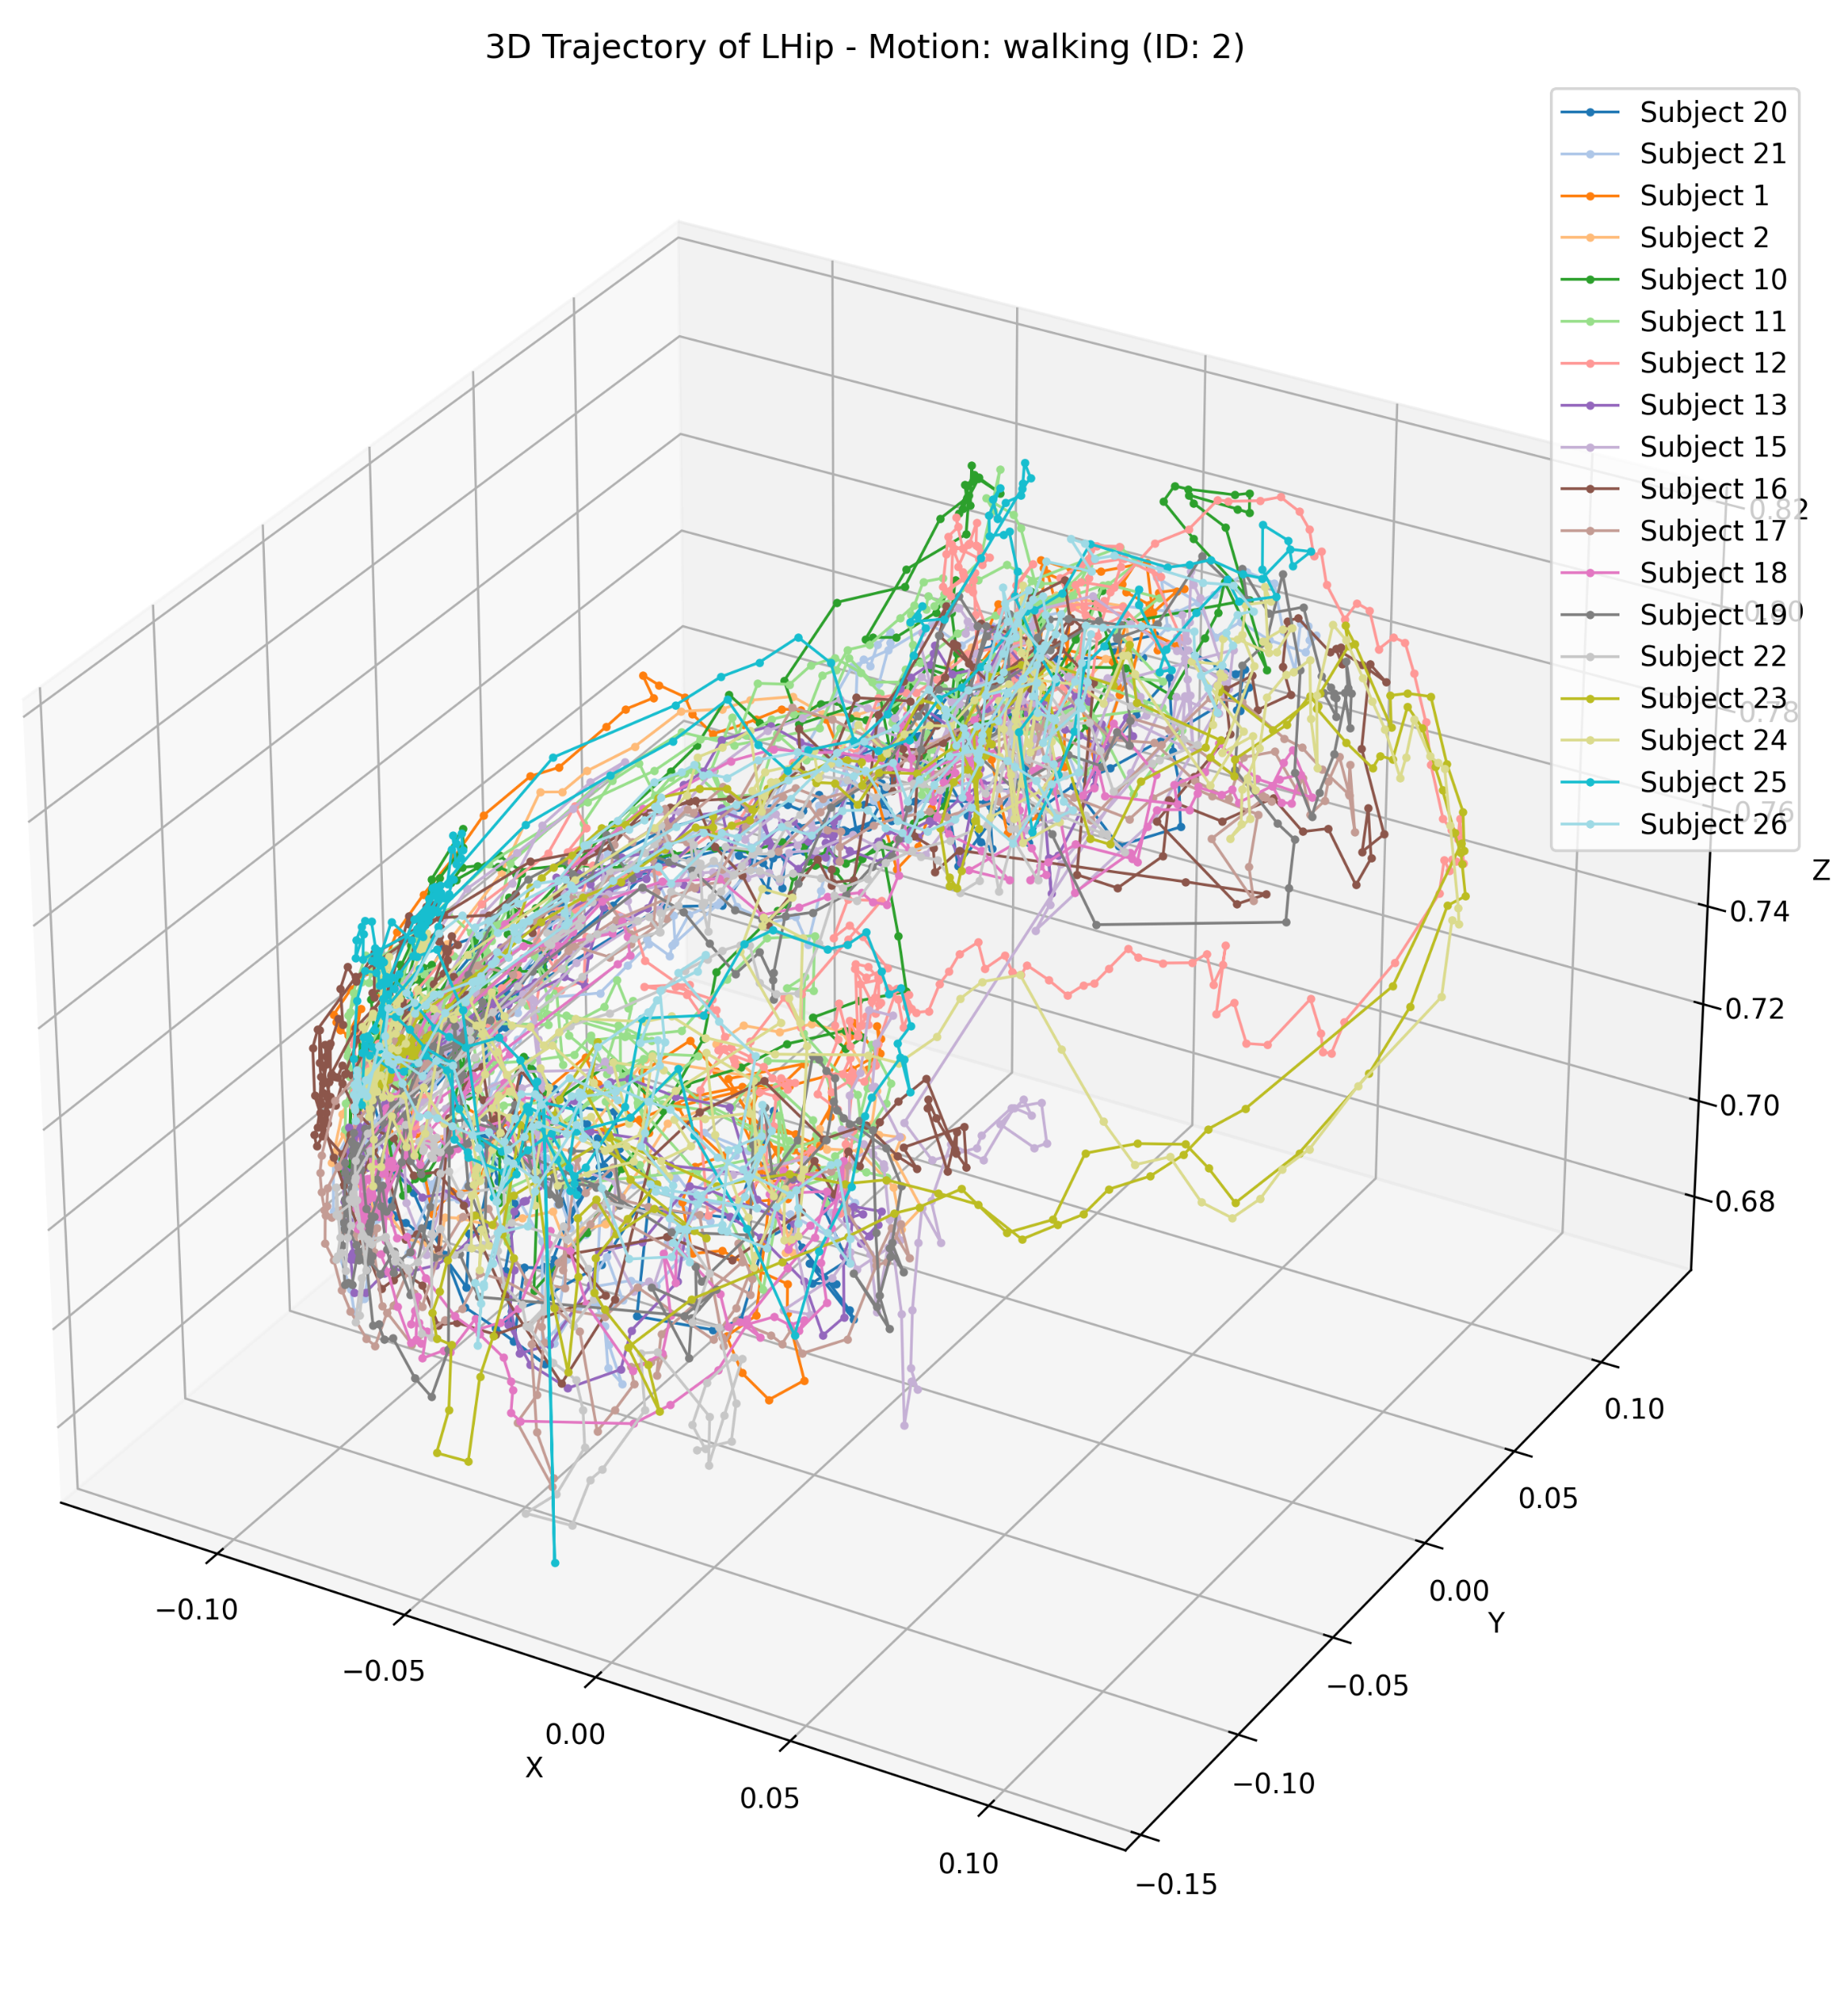
Joint trajectory across all subjects
Joint: Left Hip
Motion: Walking
Notes:
20 subjects here

Slide 7
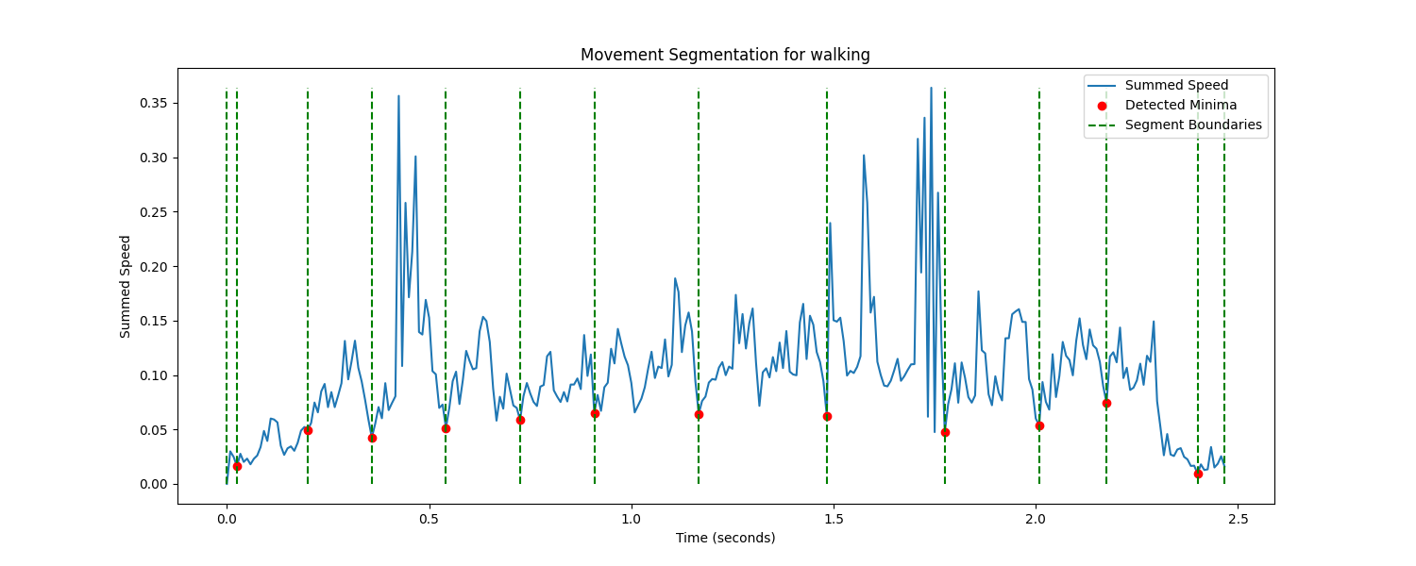
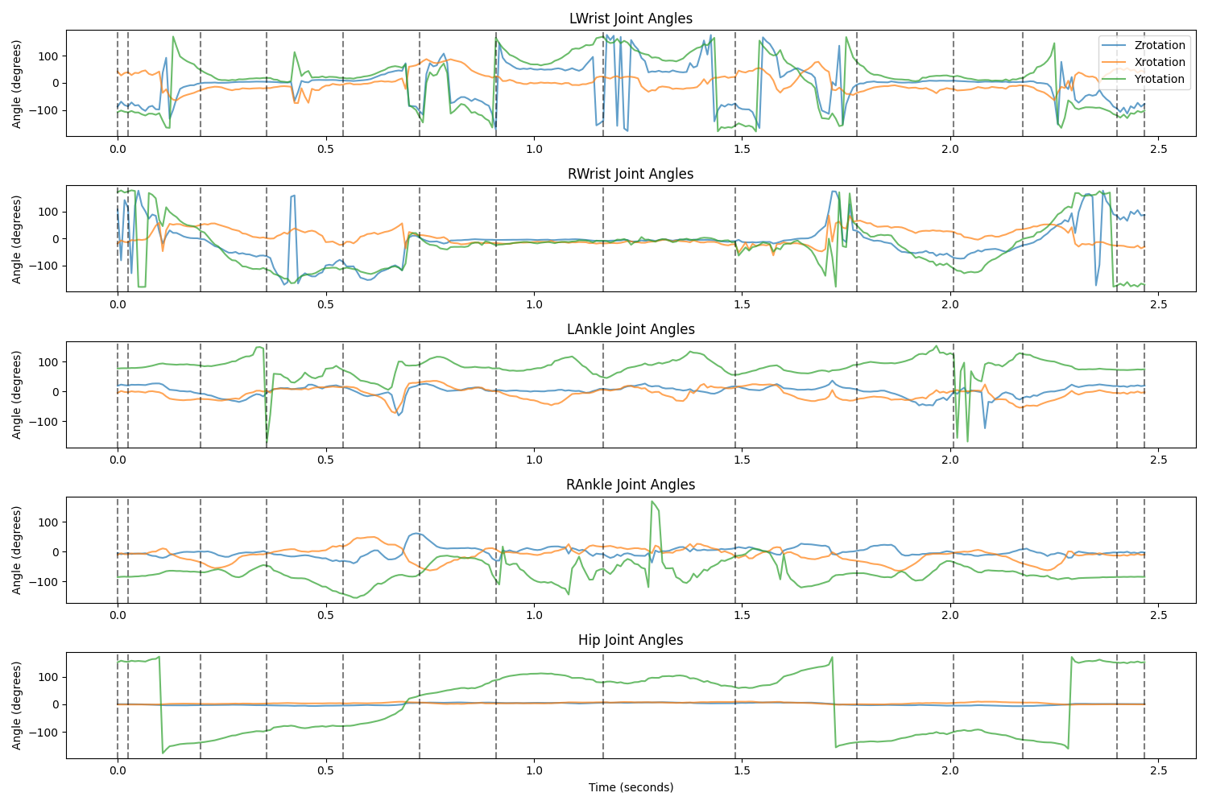
Data Segmentation
Partition sequences into segments in time
Boundaries: minima of summed speed of the wrist and foot markers limited to a min distance of 160 ms (19 frames)
Notes:
The joint angles of each movement sequence were partitioned into segments in the temporal dimension.

Slide 8
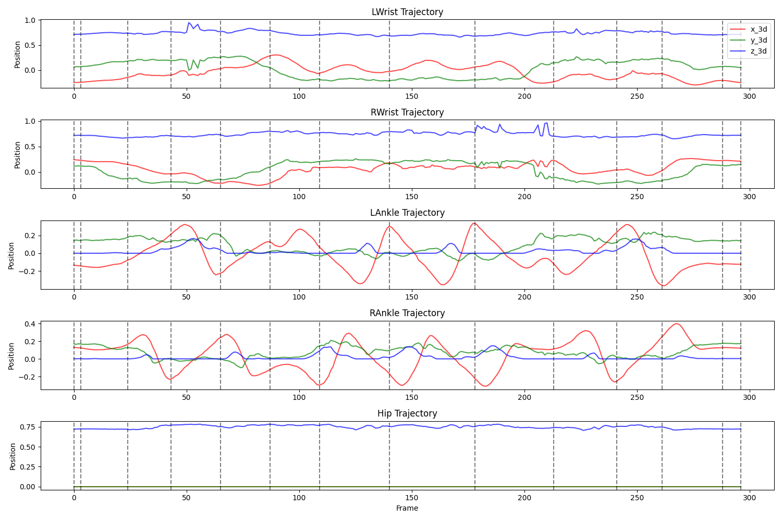
Data Segmentation

Slide 9
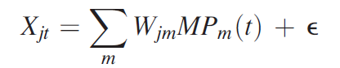
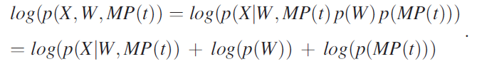
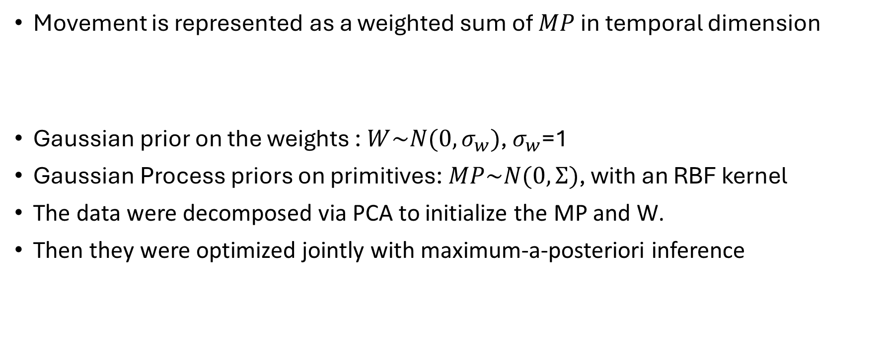
TMP model
Movement is represented as a weighted sum of $MP$ in temporal dimension
Gaussian prior on the weights : $W\sim N(0, σ_{w})$, $σ_{w}$=1
Gaussian Process priors on primitives:$MP\sim N(0,Ʃ)$, with an RBF kernel
The data were decomposed via PCA to initialize the MP and W.
Then they were optimized jointly with maximum-a-posteriori inference
Notes:
The model parameters, i.e., the
weights and primitives,

Slide 10
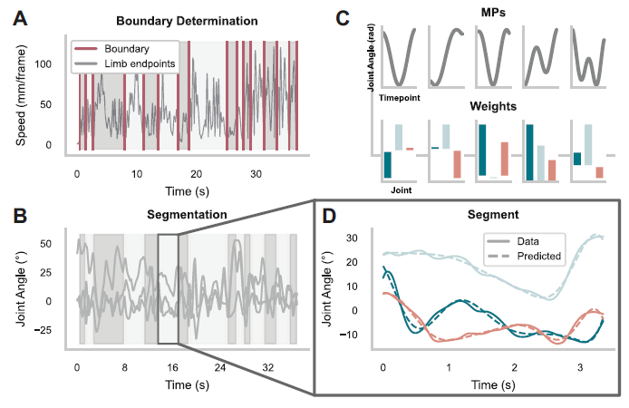
TMP model
Leh et al (2023)

Slide 11
Training
Optimization:
Adam optimizer for initial optimization (faster but less precise)
L-BFGS optimizer for fine-tuning (slower but more precise)
Loss :
Minimizing the negative log joint probability
Monitoring:
Learning curve and VAF (Variance Accounted For)
Model Evaluation:
VAF & Laplace approx. of joint prob
Notes:
Training stops when the relative gradient length becomes smaller than a threshold (5e-4) This indicates the optimization has converged
Two-Phase Optimization Process:
Phase 1 (Adam): The model is trained using the Adam optimizer for a specified number of steps (adam_steps, default 1000)
Phase 2 (L-BFGS): Following Adam optimization, L-BFGS is used for further refinement (bfgs_steps, default 1000)
At each step, the model's loss is computed (negative log joint probability) and backpropagation is used to update the parameters

Slide 12
Achievements
Steps that didn’t work:
Feed all motions to one TMP model once: VAF = 30%
Limited data samples (40 subjects for now)
Current stage:
Single motion extraction for each subject
Segmentation
Feed all segments into a TMP model for each motion
VAF = 70-80%
Notes:
Based on the paper, e should get 95% VAF

Slide 13
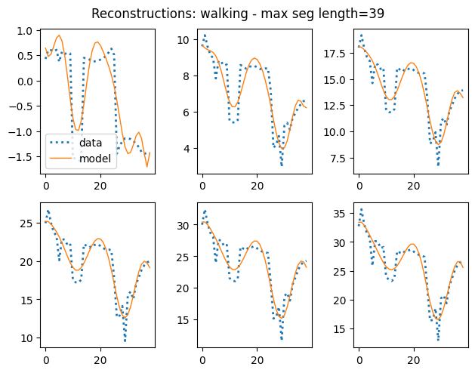
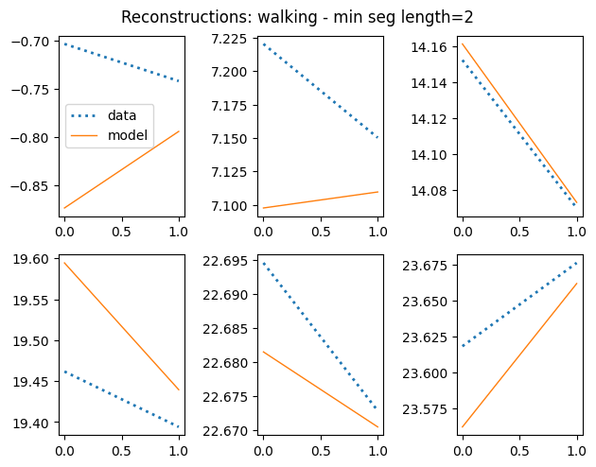
Motion=walking
num_mp = 10 , num_t_points = 30
VAF = 80%
Notes:
num_t_points defines the temporal resolution of the movement primitives

Slide 14
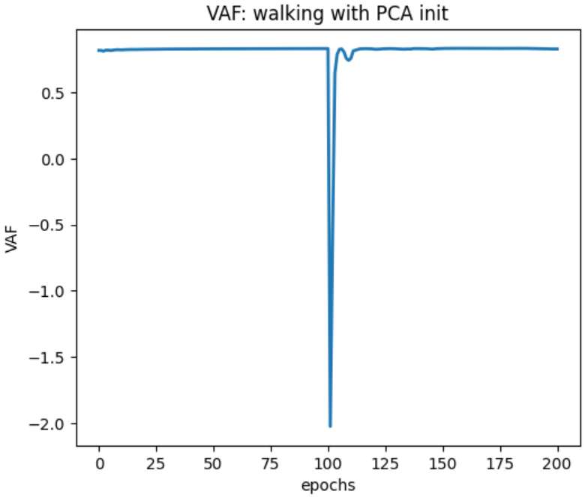
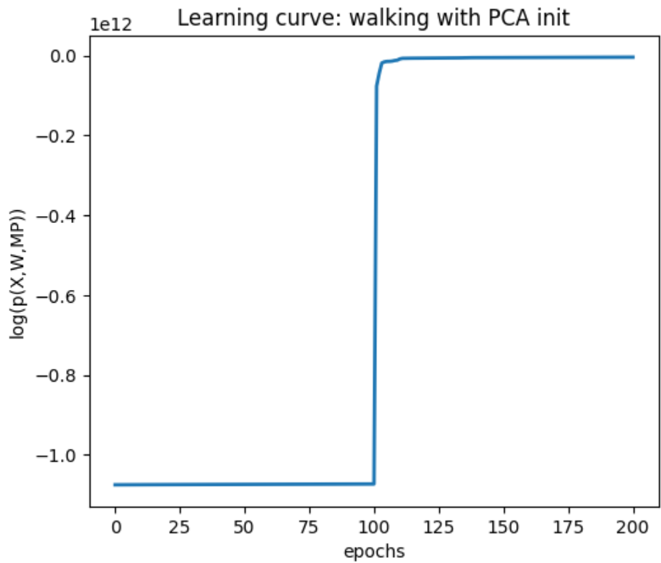
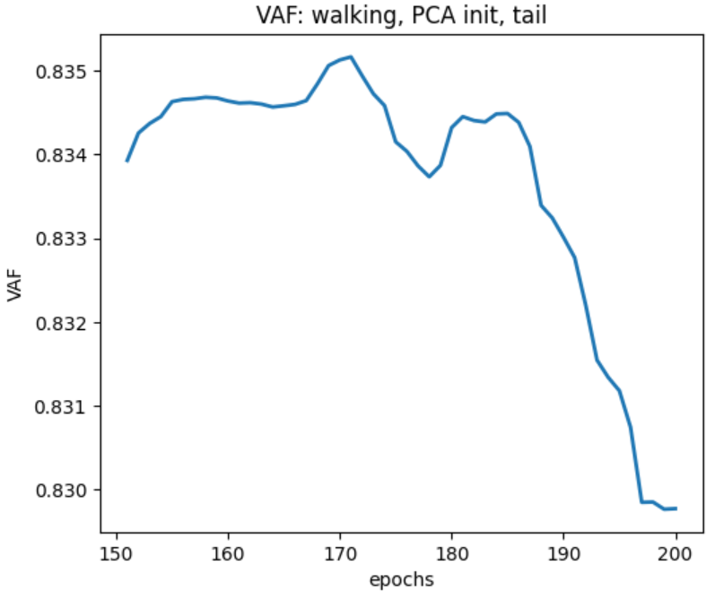
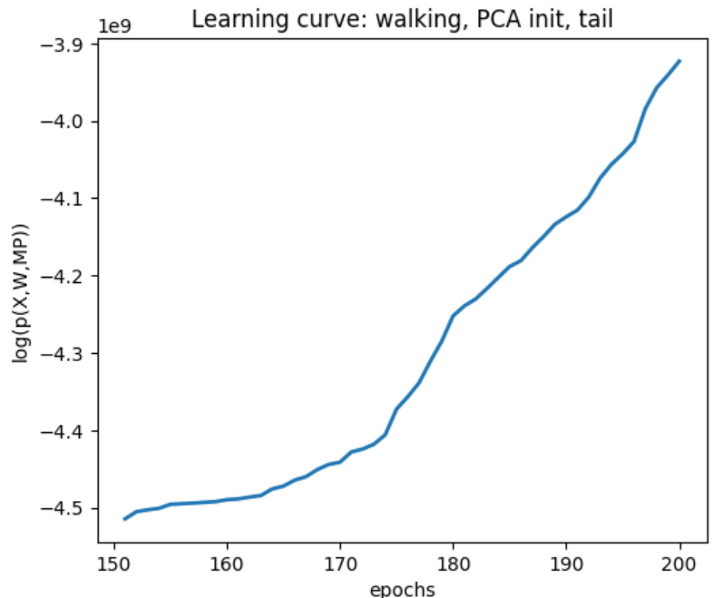
Notes:
num_t_points defines the temporal resolution of the movement primitives

Slide 15
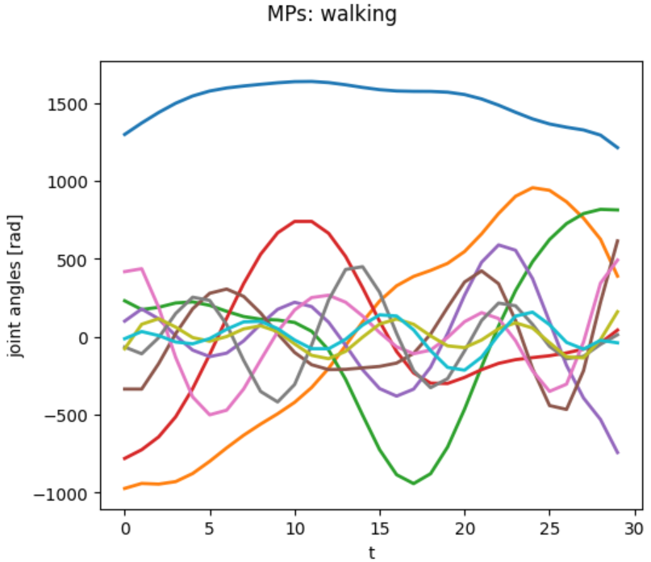
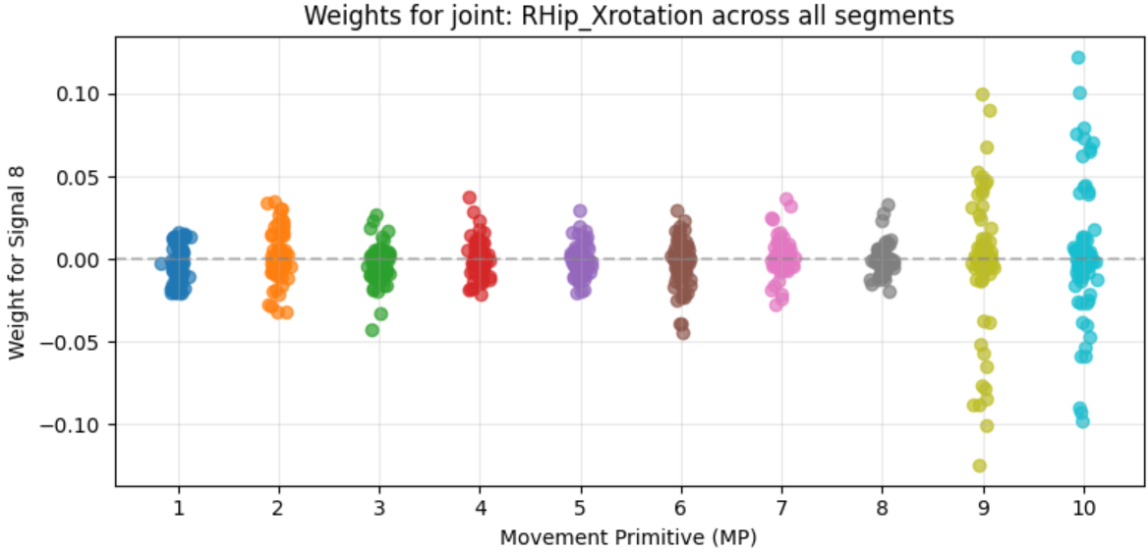
MP visualization

Slide 16
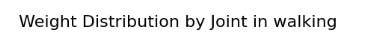
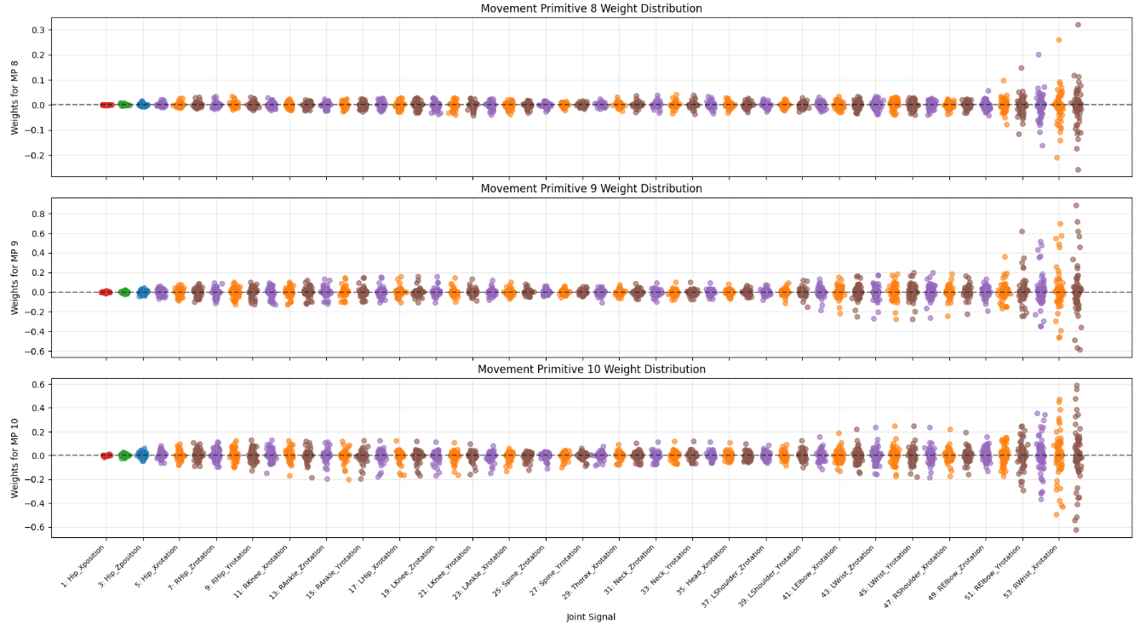
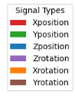
Weights distribution

Slide 17
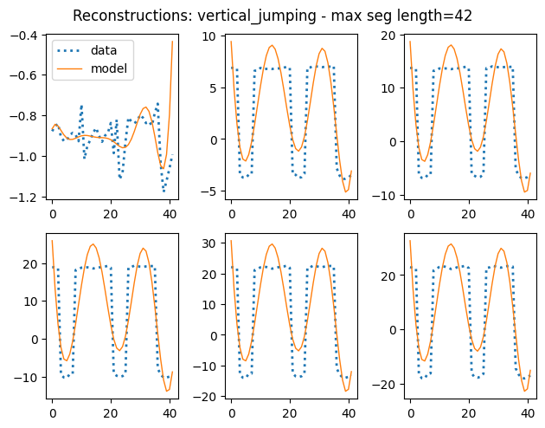
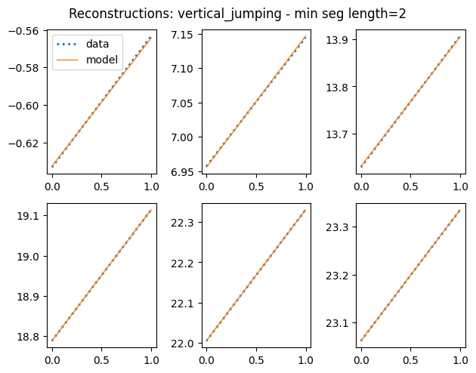
Motion= vertical_jumping , 241 segments
num_mp = 10 , num_t_points = 30
VAF = 67%
Notes:
num_t_points defines the temporal resolution of the movement primitives

Slide 18
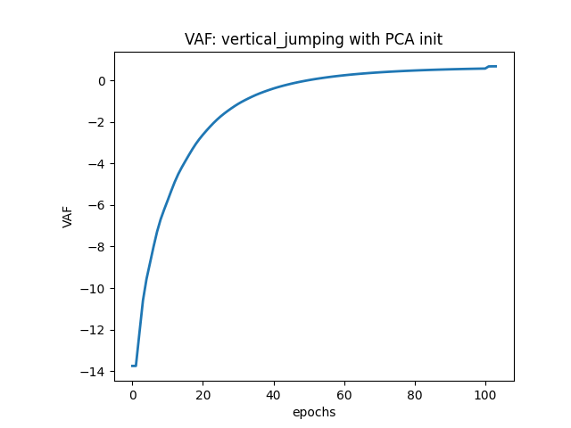
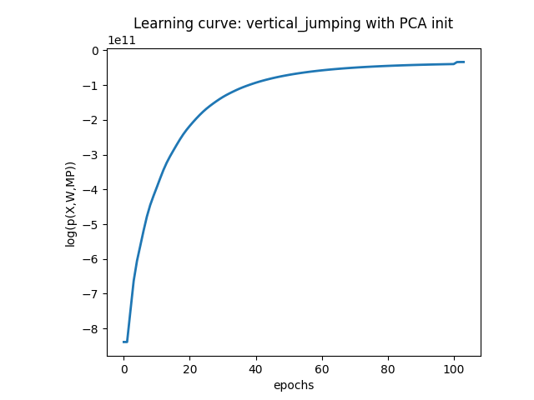
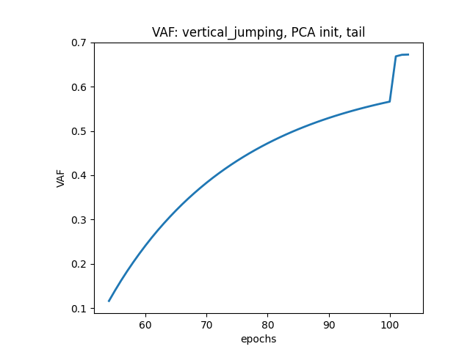
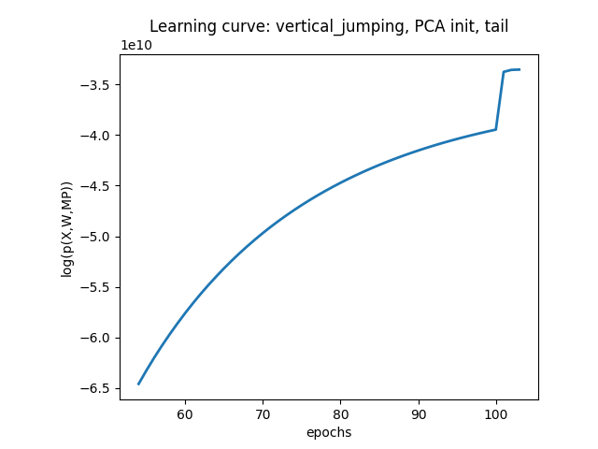

Slide 19
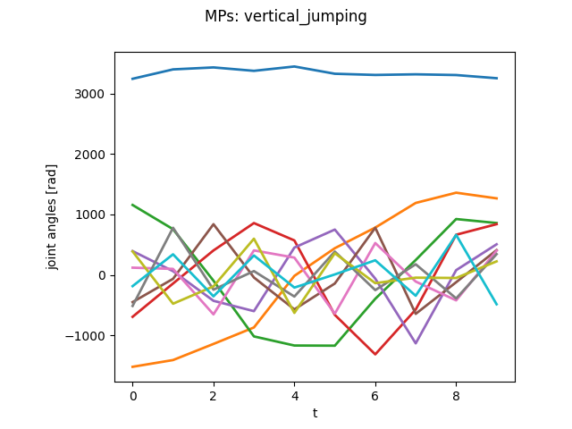
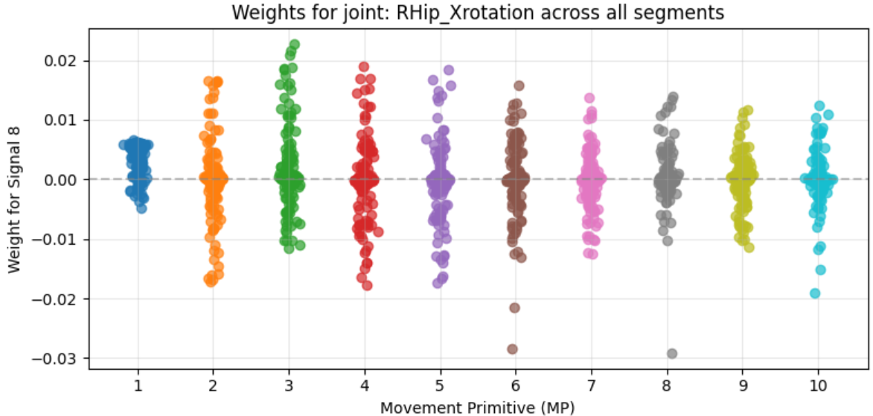
MP visualization

Slide 20
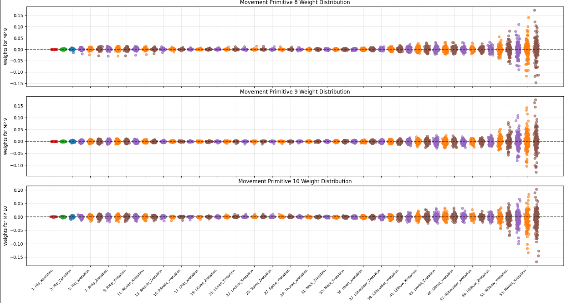
Weights distribution

Slide 21
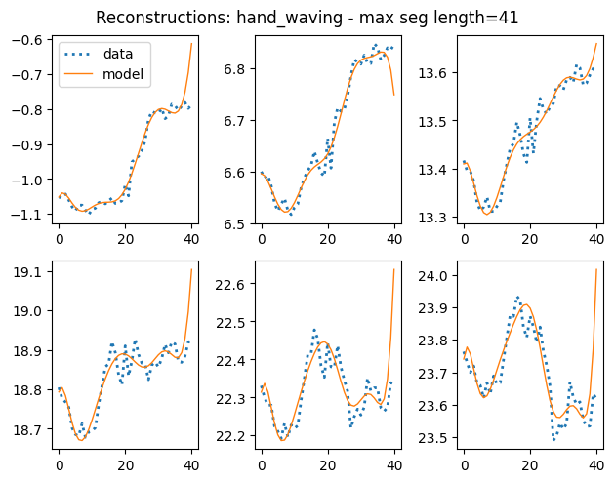
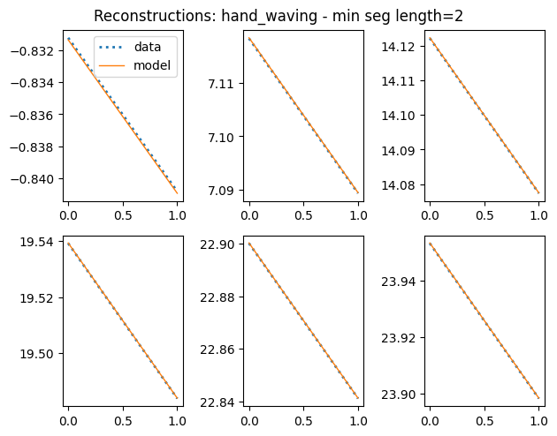
Motion=hand_waving , 224 segments
num_mp = 10 , num_t_points = 30
VAF = 70%
Notes:
num_t_points defines the temporal resolution of the movement primitives

Slide 22
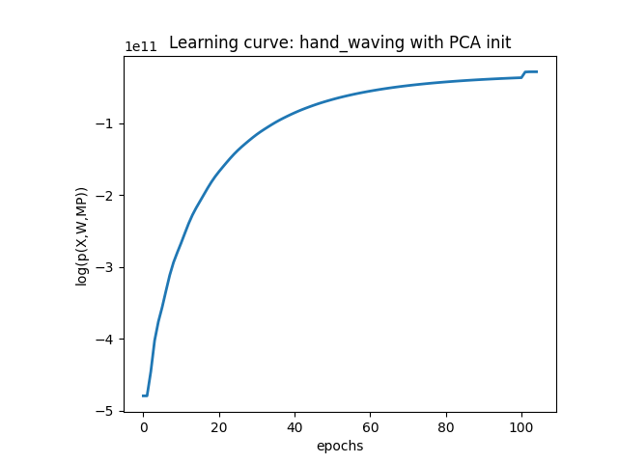
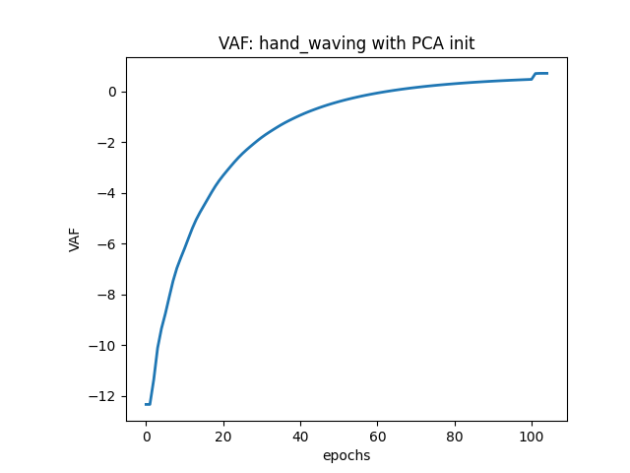
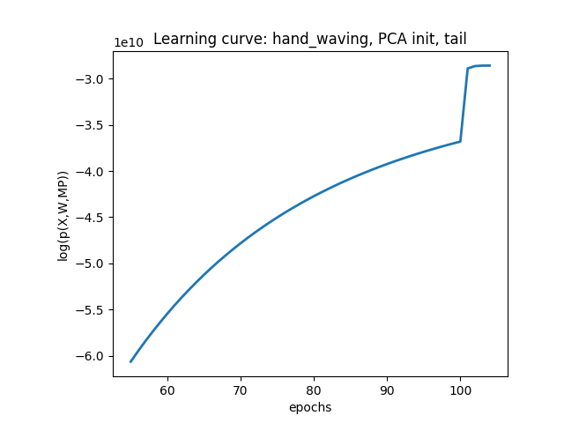
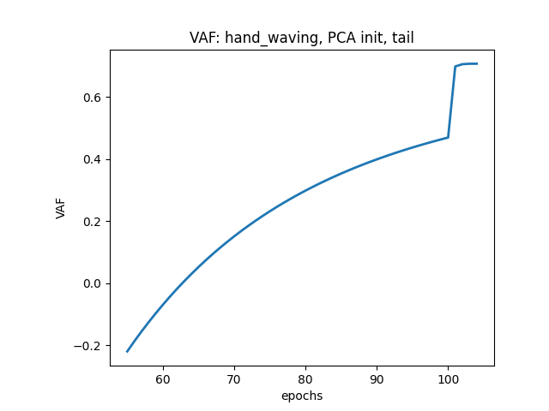

Slide 23
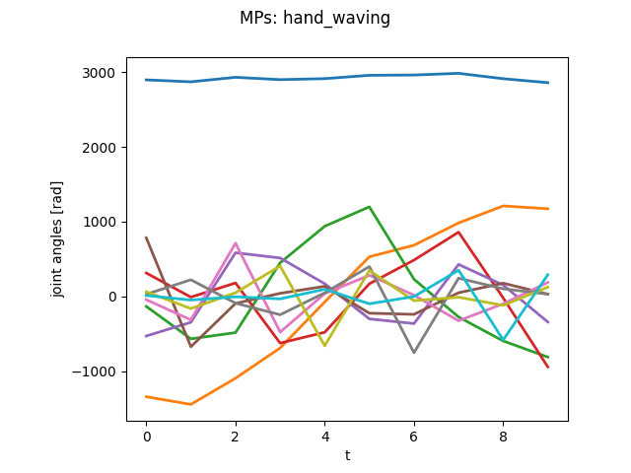
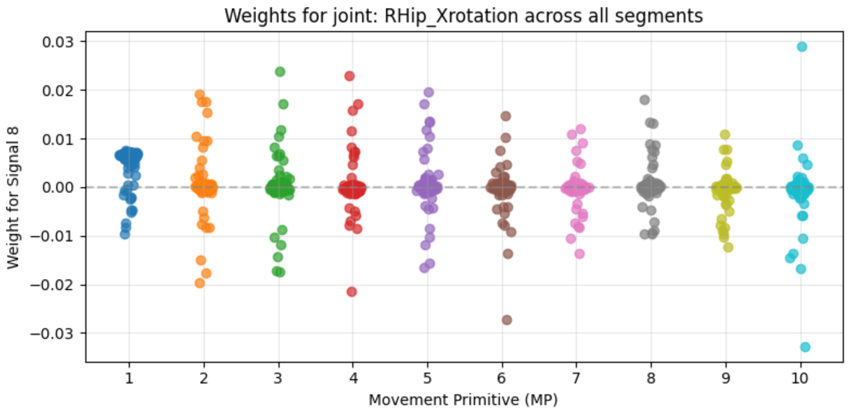
MP visualization

Slide 24
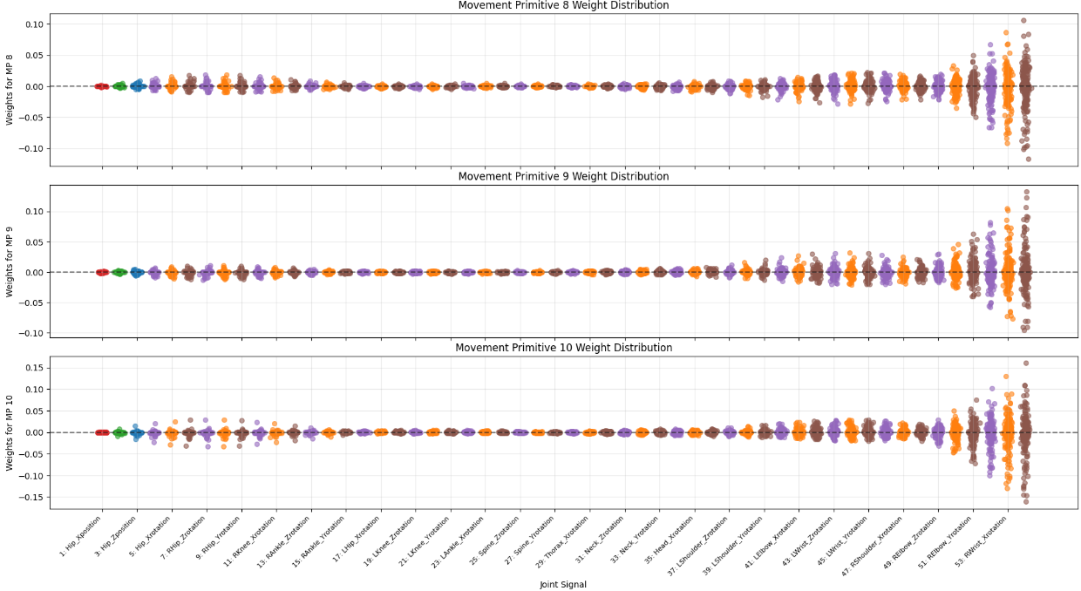
Weights distribution

Slide 25
End

